Slide 1
Alpha Demo: Hikari no To
Computer Games Laboratory 2017/2018
Team Pick One:
Muhammad Inshal Uddin
Paul Preißner
Jonas Mayer
Artem Bishev
Technical University of Munich
10.01.2018

Slide 2
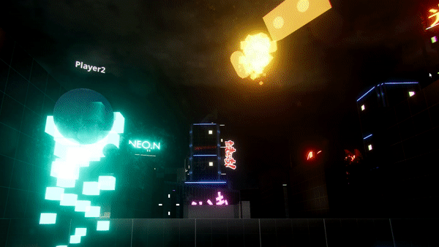
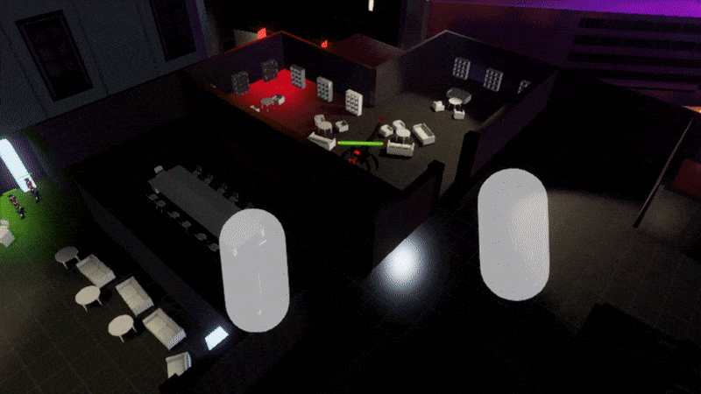
Dungeon Master
RGB
Ping Arrow Hands
Throwables
Next steps:
Polishing
FoW
Simple Teleporting

Slide 3
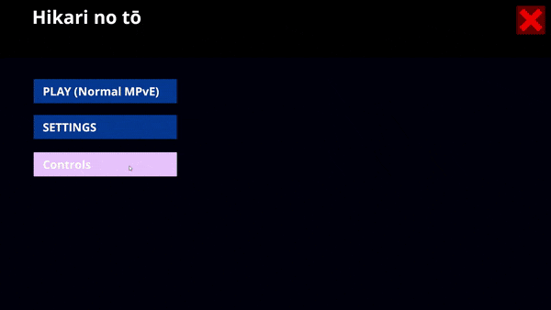
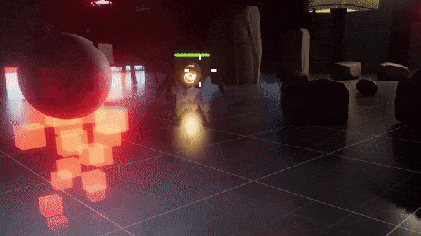
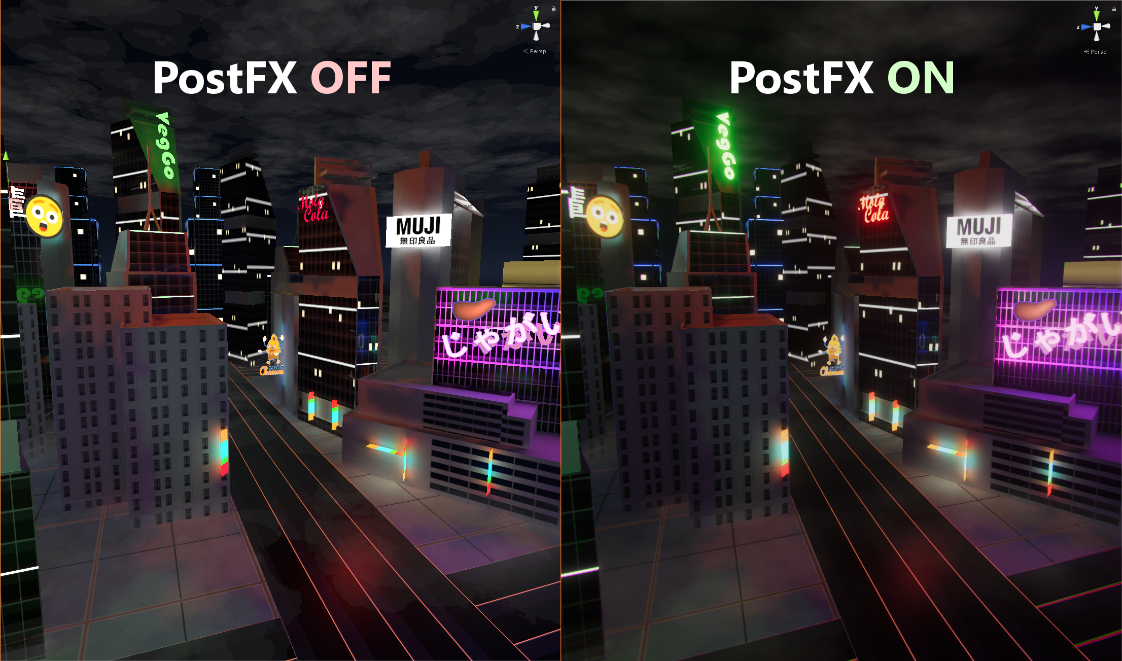
Visuals & UI
Main menu, UI
FX & post FX
Backdrop scene
Props/Rooms
Hit feedback
Next steps:
TBD

Slide 4
Enemies
Four enemy types with two unique models
Includes one boss

Slide 5
Four Player Classes
The Infiltrator
Detect Enemies
Invisibility
Backstab
The Berserker
Get Adrenaline on Kills
Berserk Mode
The Soldier
Blind Fire
Laser Beam
The Sumo
More Health
Area of Effect Attack
Sumo Blast

Slide 6
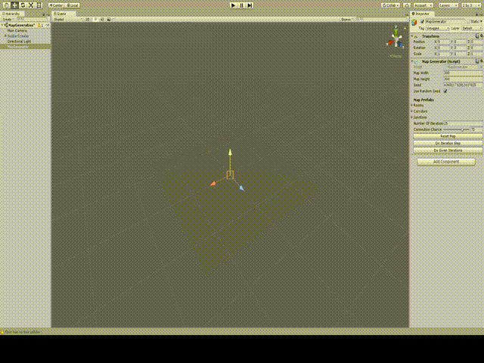
Random Map Generator
“Map Object” Prefabs
Exit Markers
Bounding Box
Allow Connections
Algorithm
Get all exits
Attach a new map object
Connection chance
Overlap checks
Map boundary checks
Rinse and Repeat

